Slide 1
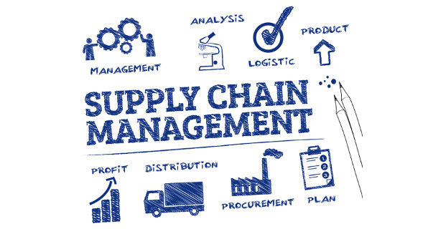
Supply Chain Analysis

Slide 2
Introduction:
This database offers numerous analytical concepts along with a variety of
information regarding multiple supply chain management platform viewpoints.
The main objectives of this project are:-
Utilize tools like Excel, Power BI, Tableau to thoroughly cover all ten Key Performance Indicators (KPIs) in the report, resulting in detailed analysis.
Finding relevant connections among the table so that when joined together they can show even better insights which cannot be presented in isolation.
Examine each table, seek to identify unique findings for every component of the data.
Obtain deeper insights beyond raw data by aggregating and calculating information, uncovering hidden patterns and trends.
To come up with recommendations which helps the store to increase sales, improve customer satisfaction and operational efficiency.

Slide 3
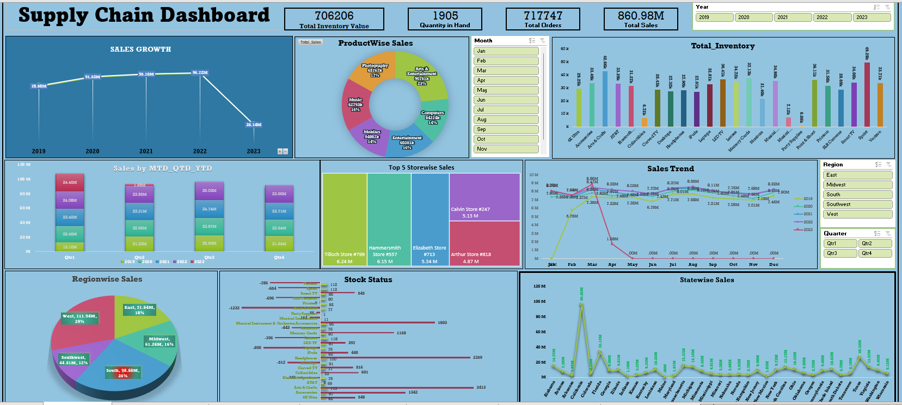

Slide 4
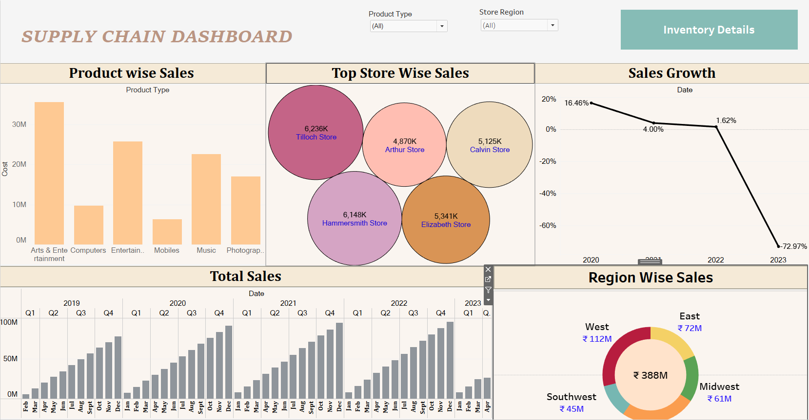

Slide 5
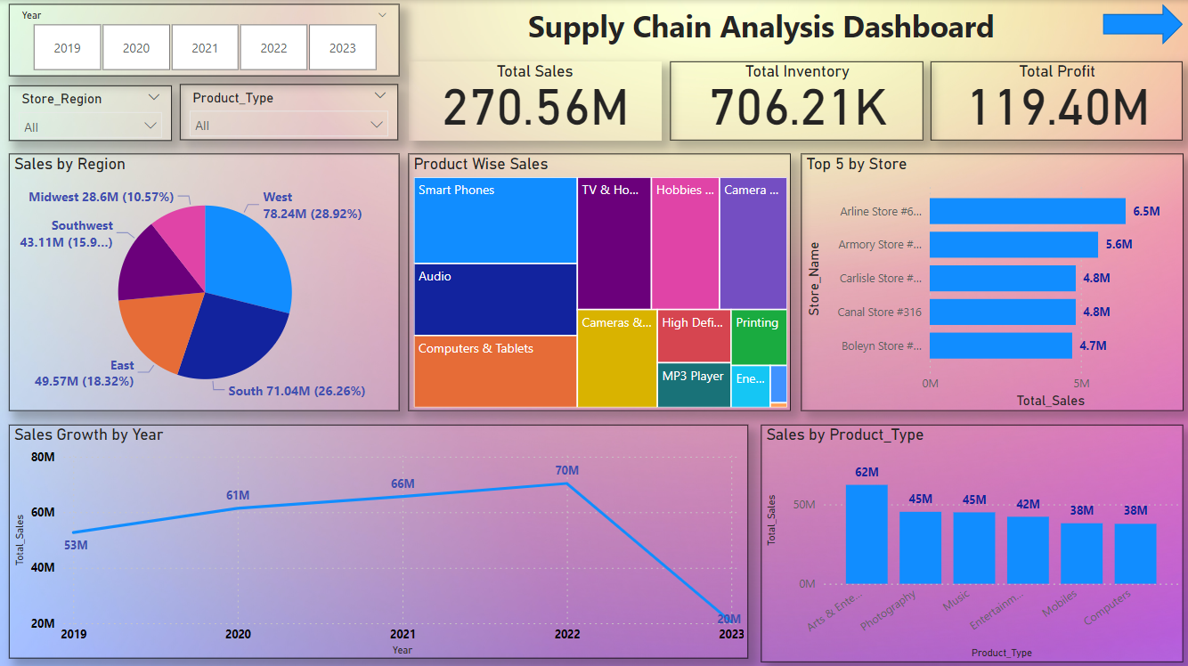

Slide 6
Observation :
The overall sales growth is gradually increasing with the highest total sales of 97.72M approximately in the year 2022. In 2023 the total sales recorded till Apr month is 26.14M approximately.
The Arts & Entertainment category has the highest sales with 62M approximately.
The Computer category has the least sales with 38M approximately.
The West region has the highest sales of 72.24M approximately with California state alone accounting to 7.2M approximately making it the state with highest sales. However the Tiloch Store from Florida has the highest sales of 13.57M.
The Midwest region has the least sales of 28.6M approximately accounting to only 10.57% of the total sales.
The total on hand quantity is 1905. Arts & Entertainment product type, which has the highest sales has the least amount of on hand quantity 242.
At 293, Smart Phones has the highest on hand quantity where as Party & Celebration has the lowest on hand quantity at 1.

Slide 7
Conclusion :
Our supply chain manufacturing project has yielded significant successes, enhancing operational efficiency and reducing costs.
Despite challenges faced, lessons learned have paved the way for continuous improvement. The project's impact on manufacturing operations is evident through increased production speed and improved product quality.
Customer satisfaction has risen, reinforcing our market position. Looking ahead, we recommend ongoing investments in technology and process optimization to sustain these gains and ensure long-term resilience.
This project has not only transformed our supply chain but positioned us for sustained success in a competitive landscape.

Slide 8
Thank You

